Slide 1
Presentation: Assignment 03 Mappings, Seven Stages of Action, and Levels of Design
Group 36

Slide 2
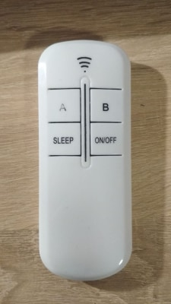
Task Description
User is sleepy and he/she wants to make a nap. User can use remote control to switch to sleep mode in the room. Sleep mode in smart home should cause also reducing temperature in the room, covering blinds etc. (it is not just turning off the light). If user want just to turn off the light he/she of course can use light switch on the wall.

Slide 3
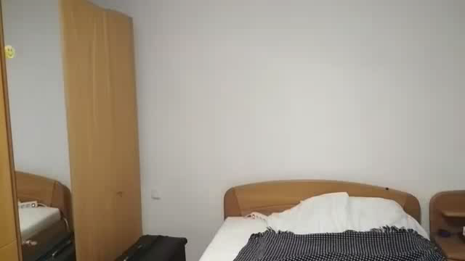
Stage 1: Goal
User is sleepy and he/she want to make a nap.

Slide 4
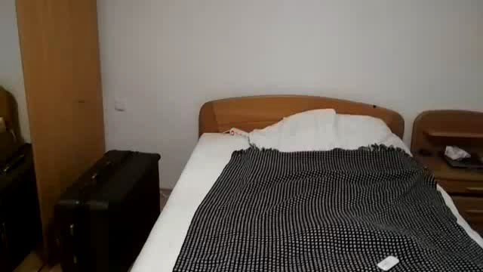
Stage 2: Plan
Change currently turned on light in the room to some kind of sleep mode or just turn off the light

Slide 5
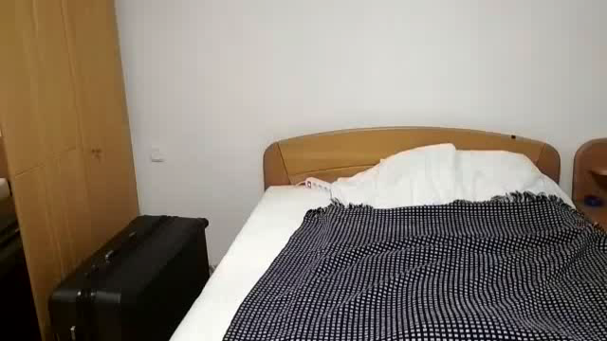
Stage 3: Specify
User is determining how to get this plan done. User has two ways to achieve the goal: use light switch on the wall or use a pilot. User decided to use a remote controll. He/she also decided to click SLEEP buton in order to switch to sleep mode in the room

Slide 6
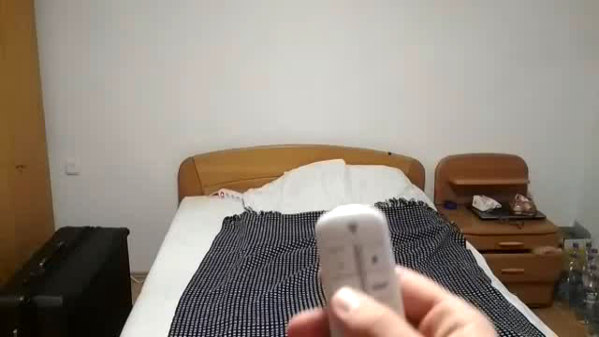
Stage 4: Perform
User is clicking SLEEP button

Slide 7
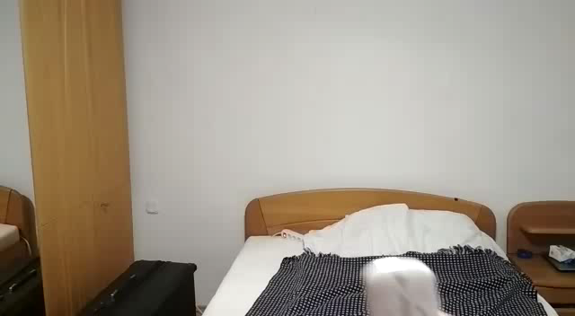
Stage 5: Perceive
Light signifire is turn on on the remote control. In the user`s room was immediately flash of light

Slide 8
Potential Gulf
The gulf was when the user was trying to figure out what happened. The idea was to prepare room to user`s nap. But the expectations failed after clicking SLEEP button.

Slide 9
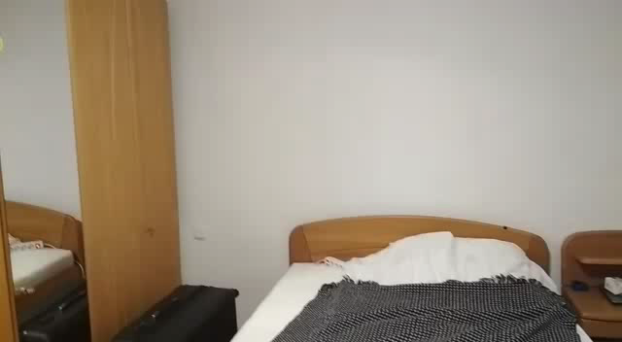
Stage 6: Interpret
User is trying to make sense and interpreting what happened in the room.

Slide 10
Stage 7: Compare
User wanted to turn on the sleep mode in the room. Or even turn off the light. But regarding to his/her action, gets unknown feedback, definitely unexpected.

Slide 11

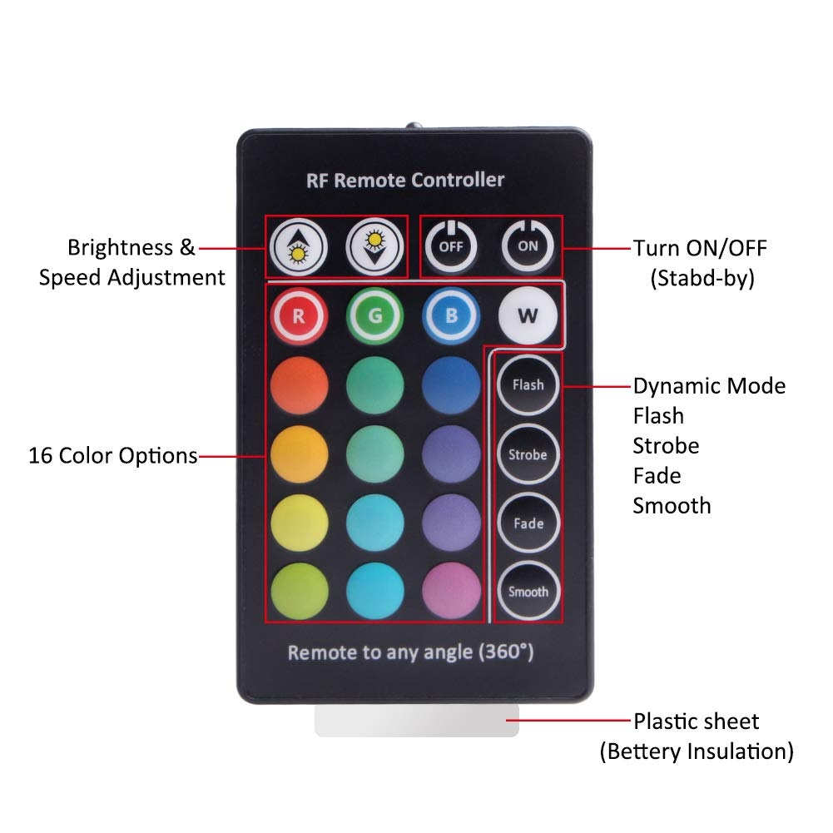
The Visceral Level of Processing
The first impression that a user of this remote control gets is that it is very nice looking, easy to figure out and super light (8.2 ounces = 28 g). The designer of this pilot removed more advanced functions that could be programmed to this pilot easily and left only the basics in order to avoid having too many buttons (that would make the remote control too complicated for a user at first glance). Also colors and shapes of buttons are very modern looking which emphasize the attractive look of the pilot.

Slide 12
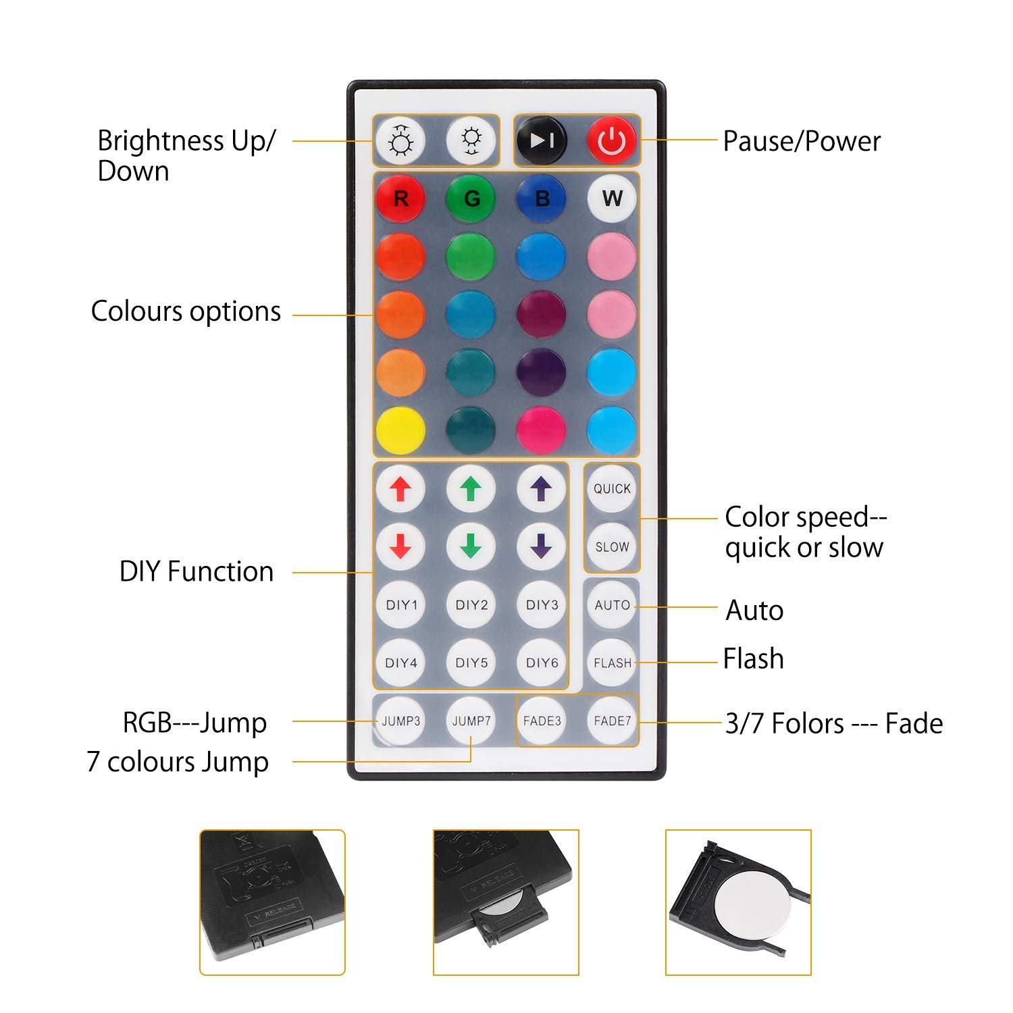
The Behavioral Level of Processing
The designer of this remote control inserted there more buttons and allowed user to do more functions. However, that didn't make the pilot too complicated. Using this pilot is very easy for user and allows him to do quite advanced things with many options that he has. The usability of every single button is very easy to figure out because of colors, text and symbols used on them. This design makes user to feel that he can master the remote control and all functions very easily.

Slide 13
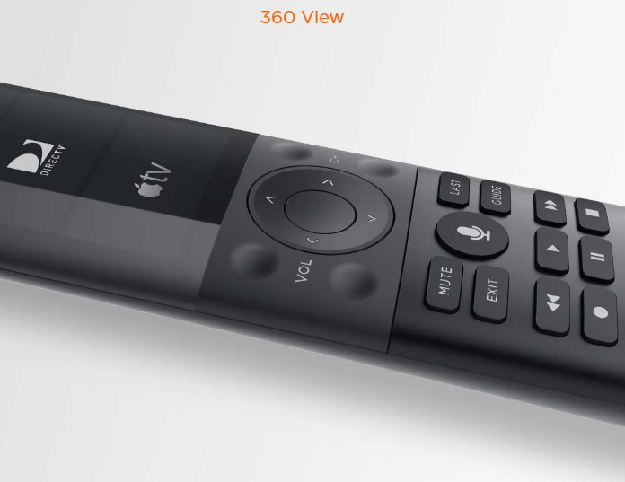
The Reflective Level of Processing
This remote control is designed by luxurious smart home company - Savant. Their products are designed for the super rich ( allegedly Steve Jobs used it). For this reason this remote control invokes reflective response because everybody would want to have a product of brand that was used by the richest people in the world. Moreover, the design (screen, modern shape, color) and variability of options makes user want to present this pilot to every guest that would come to his house. Even if the pilot would have some disadvantages and would create some problems when user want to figure it out, the user would most likely ignore them due to the prestige that comes with owning such home applience

